Slide 1






An S.L.C. Hollywood High School

Slide 2
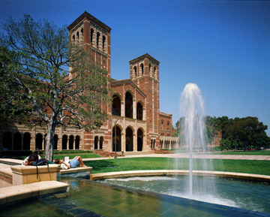
Why Join HNAS?
HNAS also has an incredible 3-year culinary arts program.
HNAS will have a student-run restaurant on campus.
All 9th grade students take a field trip to a university.
Health & Culinary internships.

Slide 3
Why Join HNAS?
HNAS is an SLC that offers students classes that are designed for their needs and interests.
HNAS offers a full curriculum of courses that meet requirements for college and university admissions.
Access to Honors and Advanced Placement classes where you can acquire college credit.
HNAS will be offering classes such as:
  Physiology
  Psychology
  Molecular Biology
  Genetics
  Forensic Science

Slide 4



Why Join HNAS?
You should join HNAS if any health or science related careers interest you. Such as…
Career | Salary
Chef | $43,000
Nurse or Doctor | $56,000
Sports Therapist | $64,000
Veterinarian | $83,000
Biologist | $67,000
Restaurant Manager | $42,000
Forensic Investigator | $75,000

Slide 5
An S.L.C. Hollywood High School

